Slide 1
Welcome to the Guaranteed Loan Servicing Refresher webinar!
The event will begin shortly

Slide 2

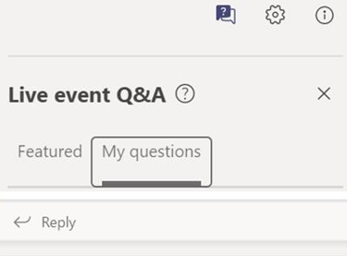
Microsoft Teams Live Event
Instructions for the live event are listed below.
One–Direction Broadcast: As an attendee, you are not able to share your audio or video feed.
Closed Captioning: To turn on closed captions, click on the three-dot menu icon at top of your screen. A sub menu should appear with various options. Click on the option titled “Turn on Live captions”
Meeting Recording: This event is being recorded. A copy of this recording will be available on the FSA website under Guaranteed Loans – Lender Toolkit.
Q&A: Participants may ask questions during the Live Event using the Q&A feature. To see all questions posted, toggle between the Featured and My Questions tab.

Slide 3
Enhancing Program Access and Delivery for Farm Loans-Key Dates
August 8: Rule Publication Date
Start of Public Comment Period
September 25: Rule Effective Date
October 7: End of Public Comment Period
This rule contains over 40 changes, clarifications, and corrections to FSA’s loan programs.

Slide 4
Specific Changes to Guaranteed Loan Program
While most changes in the rule affect the direct loan program, there are a handful of smaller but important changes to the guaranteed loan program
  Expanded opportunities for subordinations to allow refinancing of the lender’s own debt
  No longer required to take a lien on all assets to facilitate a restructure that includes a balloon installment repayment plan
  All lenders must receive FSA concurrence of eligibility of new borrowers involved in a transfer and assumption
Enhancements as a result of input for lenders, customers, and staff

Slide 5
Notable Rule Changes
Distressed Borrower Set-Aside (DBSA) Program
Direct Loan Collateral Requirements
Direct Loan Repayment Terms

Slide 6






Budgets and Terms
The changes to repayment terms and operating plans are more focused on Direct loans than Guaranteed loans but do allow for similar considerations in Guaranteed lending.
Summary of Impacts:
Commercial lenders will continue to be valued partners who work cooperatively with FSA to serve farmers and ranchers, as they are today.
The rule ensures the consideration of the use of terms that allow reasonable progress towards long-term financial goals.
To be reasonable, commercial loans must simply provide the opportunity to make progress towards those long-term needs (something that is already happening with most commercial loans), the rule does not require a Guaranteed loan to have the same margin, rates or terms of a Direct loan.

Slide 7
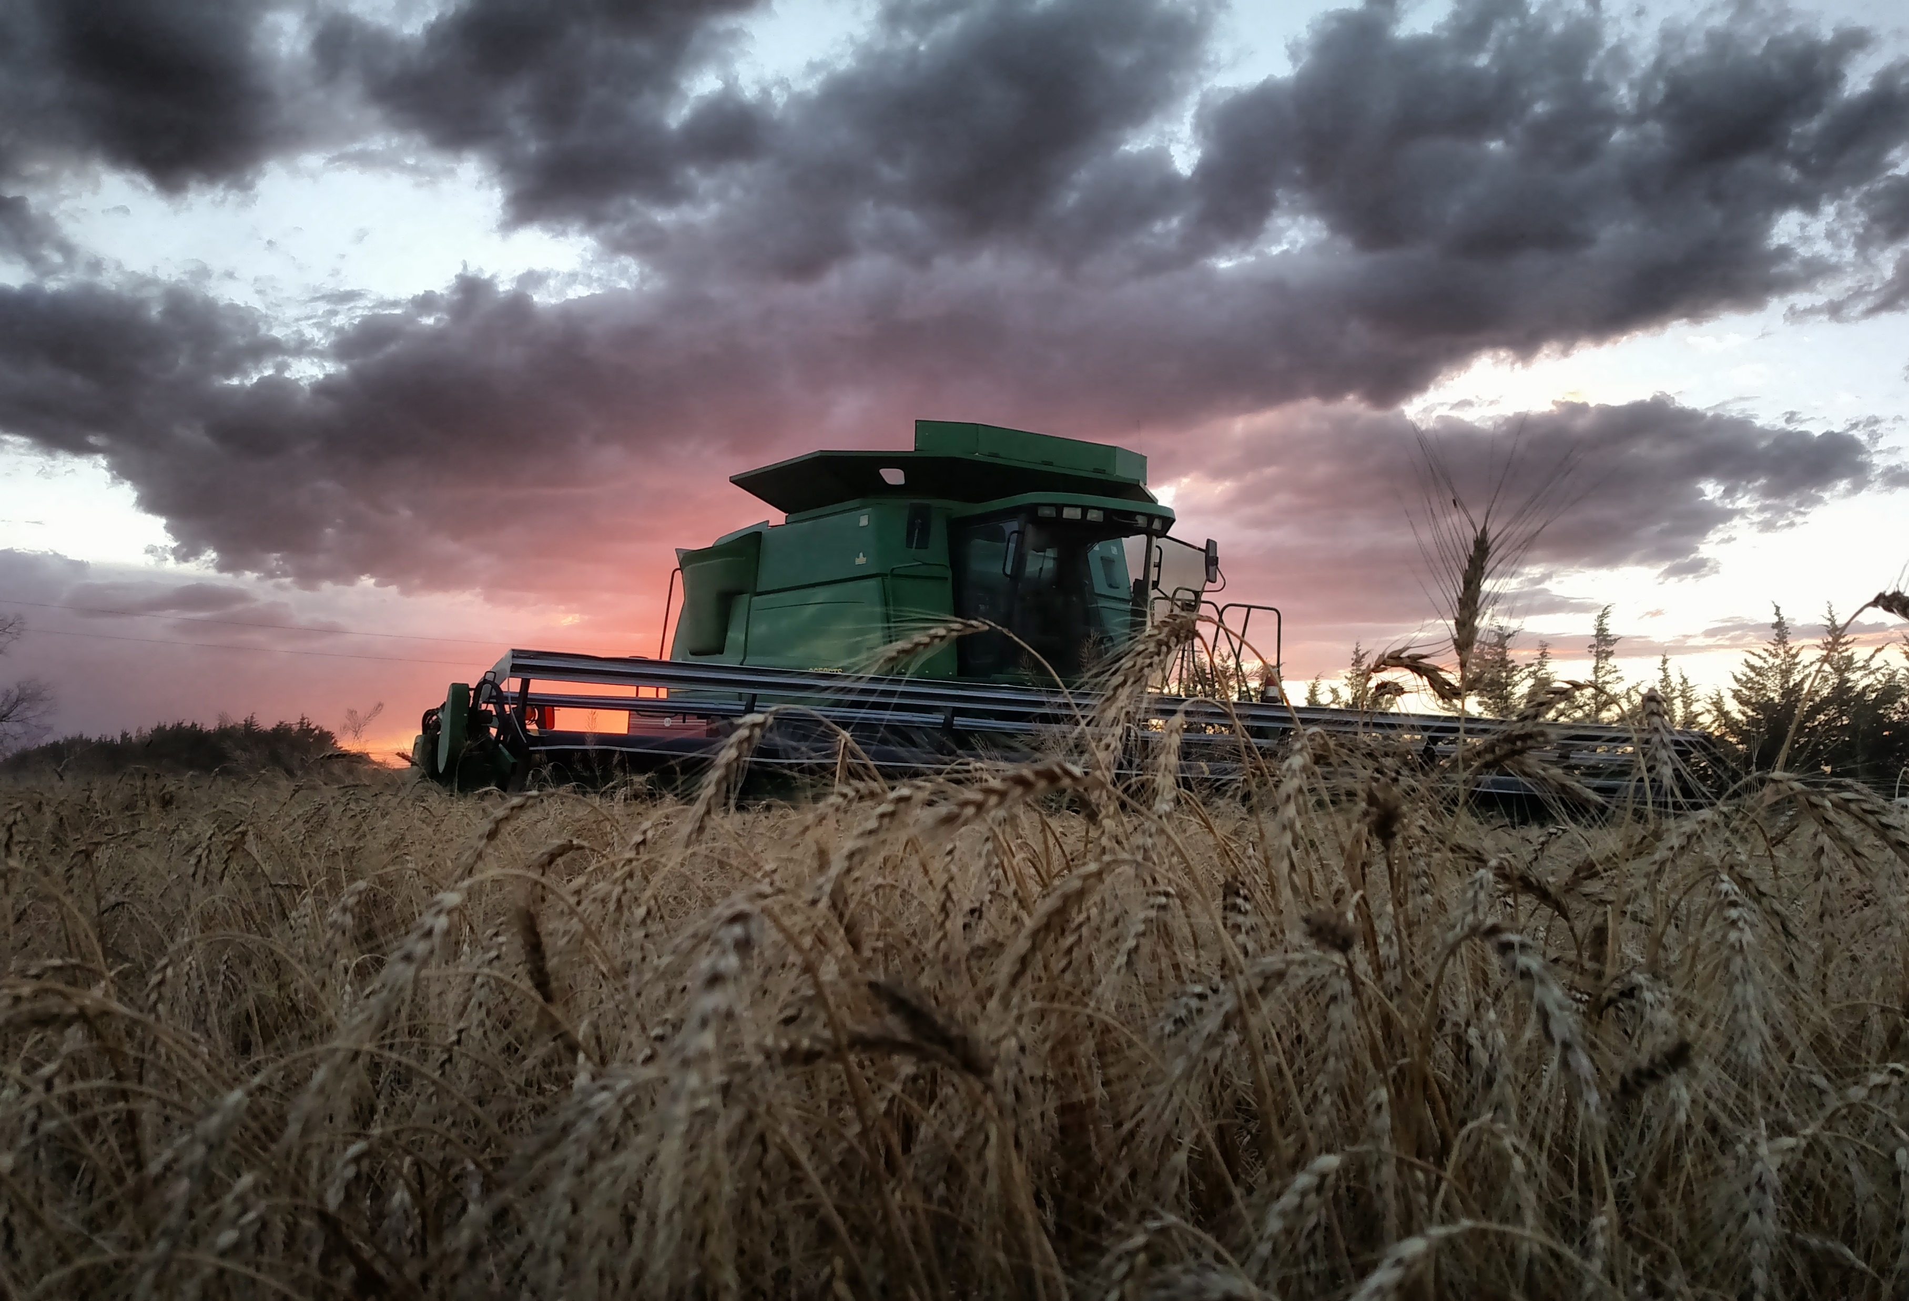

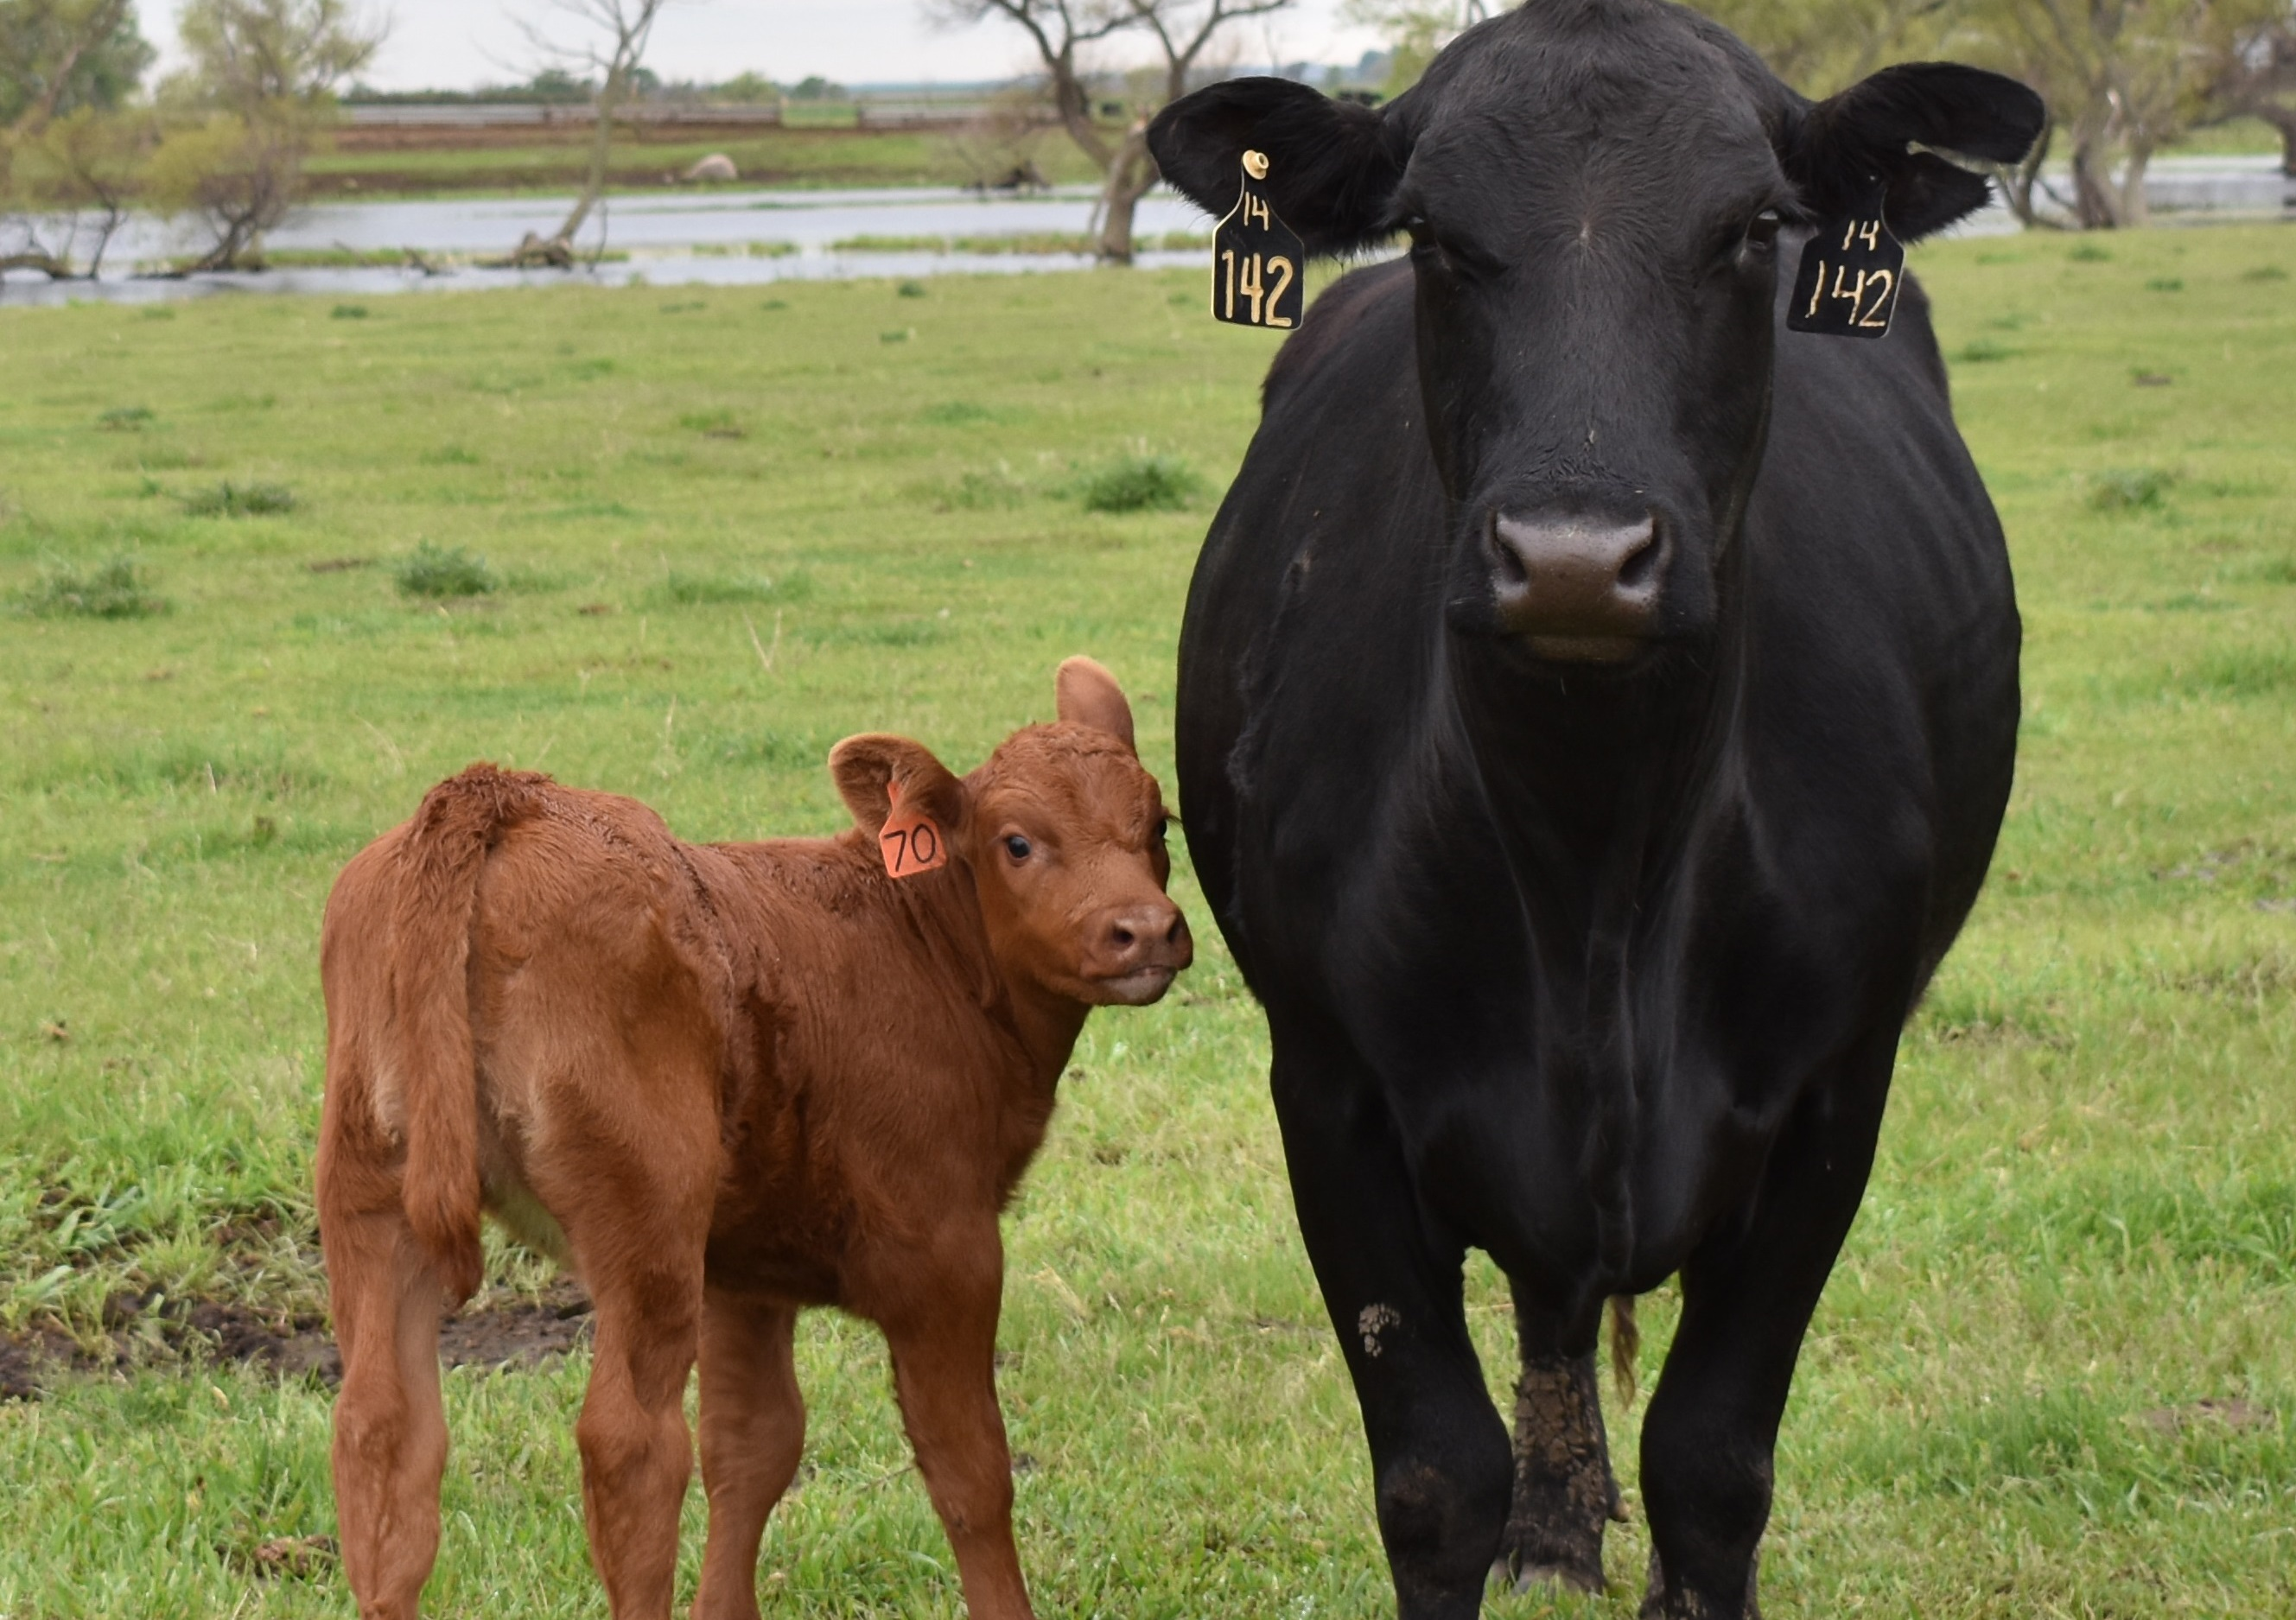
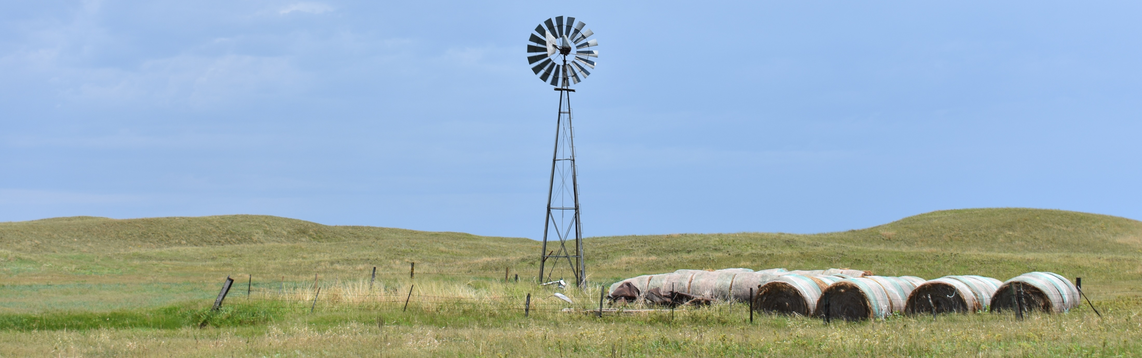
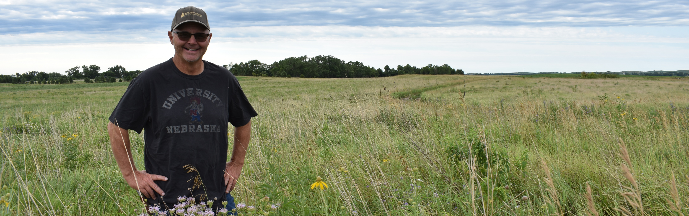
Guaranteed Loan Servicing Refresher

Slide 8
Topics
Lender Roles and Responsibilities of Maintaining a Guarantee
  Supervision of Borrower
  Supervision of Collateral
  Annual Analysis
How to Service a Delinquent Guaranteed Loan
  Reporting Delinquency to FSA
  Considering Debt Servicing Options
Emergency Advance vs. Protective Advances

Slide 9
Lender Roles and Responsibilities of Maintaining a Guarantee
FSA Handbook 2-FLP Paragraphs 262 - 265

Slide 10

Lender Role
Lenders are responsible for servicing the entire loan in a reasonable and prudent manner, protecting and accounting for collateral, and remaining the mortgagee or secured party of record.
The lender is responsible for:
  servicing their guaranteed loans as they service any other loan in their portfolio
  complying with all FSA program requirements.

Slide 11
Lender Supervision of Borrower
Loan funds are not used for unauthorized purposes
Borrower in compliance with provisions in promissory note and security instruments
Borrower in compliance with all laws and regulations applicable to the loan, collateral, and operations of the farm
Receive all payments of principal and interest on the loan as they fall due and promptly disbursing to any holder its pro-rata share, if applicable.
Perform annual analysis of the borrower’s financial conditions to determine borrower’s progress

Slide 12


Application of Payment
When a lender receives a payment from the sale of encumbered property, loan installments will be paid in the order of lien priority.
When a payment is received from the sale of unencumbered property or other sources of income, loan installments will be paid in order of their due date.

Slide 13
Lender Servicing of Collateral
Obtain income and insurance assignments when required
Ensure the borrower has or obtains marketable title to the collateral
Inspect the collateral as often as deemed necessary to properly service the loan
Ensure the borrower does not convert loan security
Ensure the proceeds from the sale or other disposition of collateral are accounted for and applied in accordance with lien priorities on which the guaranteed is based or used for the purchase of replacement collateral

Slide 14

Lender Servicing of Collateral
Ensure the loan and the collateral are protected in the event of foreclosure, bankruptcy, receivership, insolvency, condemnation, or other litigation
Ensure taxes, assessments, or ground rents against or affecting the collateral are paid
Ensure adequate insurance is maintained
Ensure that insurance loss payments, condemnation awards, or similar proceeds are applied on debts in accordance with lien priorities on which the guarantee was based, or used to rebuild or acquire needed replacement collateral

Slide 15
Annual Analysis of Borrower’s Financial Condition
The lender must perform an annual financial analysis of the borrower’s operation within 90 calendar days of the end of the borrower’s operating cycle.
An annual analysis is required for all borrowers with term loans greater than $100,000 and all line of credit loans.
For borrowers with an outstanding loan balance for existing term loans of $100,000 or less, the need for annual analysis will be determined by the Agency for SEL, CLP, and MLP lenders.

Slide 16
Annual Analysis of Borrower’s Financial Condition
FSA requires the lender to perform an annual analysis of borrower with an outstanding loan balance of $100,000 or less for SEL, CLP, and MLP lenders when any of the following exist:
  The loan is past due by more than 30 days
  A current balance sheet indicates financial deterioration, including reduction in collateral and/or values
  A credit report indicates an increase in use of credit, increase in late pays, or reports of collection activity results in a decrease in credit score.

Slide 17
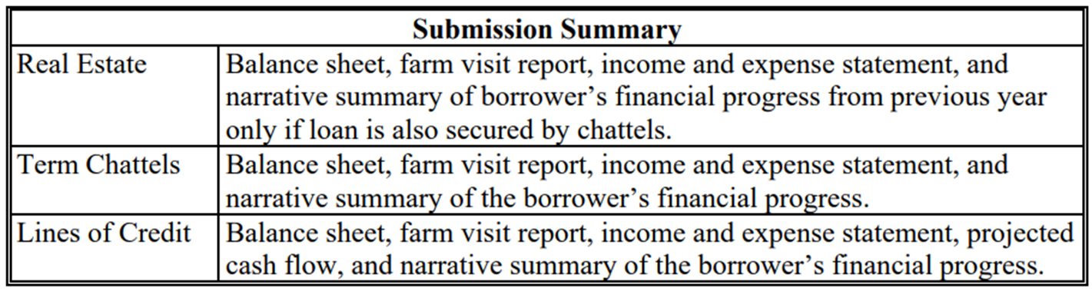
Annual Analysis – SEL and MLP
Documents submitted to FSA by SEL and MLP in Support of Annual Analysis
  These documents should be submitted within 30 calendar days of completion.
  NOTE: The SEL must receive approval from the Agency before advancing future years’ funds.

Slide 18
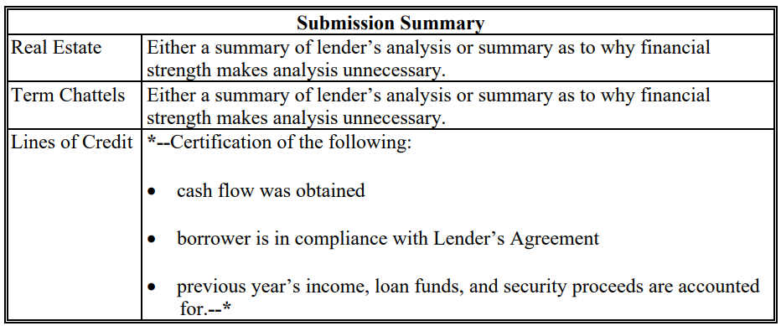
Annual Analysis – CLP
Documents submitted to FSA by CLP in Support of Annual Analysis
These documents should be submitted within 30 calendar days of completion

Slide 19
Annual Analysis – PLP
Will perform an annual analysis in accordance with the requirements established in their Lender’s Agreement and Credit Management System (CMS) and document results in the borrower file.
PLP lenders do not submit the annual analysis to FSA for review.

Slide 20
How to Service a Delinquent Guaranteed Loan
FSA Handbook 2-FLP Paragraphs 266 and 300

Slide 21
Delinquent Loan Servicing Timeline
Payment Due Date | Payment Missed
30 Calendar Days After Due Date | Borrower in Default
Within 45 Calendar Days After Due Date | Meeting Between Borrower and Lender
60 Calendar Days (after Interest Assistance (IA) Determination) | Earliest Date that Lender Can Initiate Foreclosure Action
Within 120 Calendar Days After Due Date | Loan Restructuring Plan Implemented or Decision to Liquidate Made
A borrower is in default when they are 30 days past due on a payment or in violation of provisions of the loan documents. When a default occurs, the lender is expected to work with the borrower so the loan can be brought current, and the borrower can continue the operation.

Slide 22
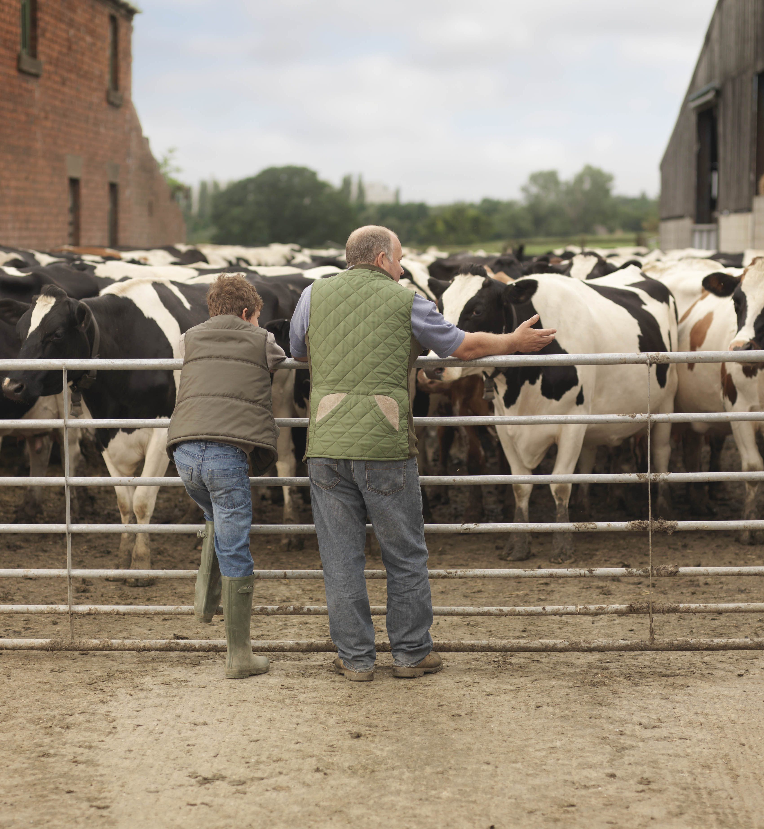
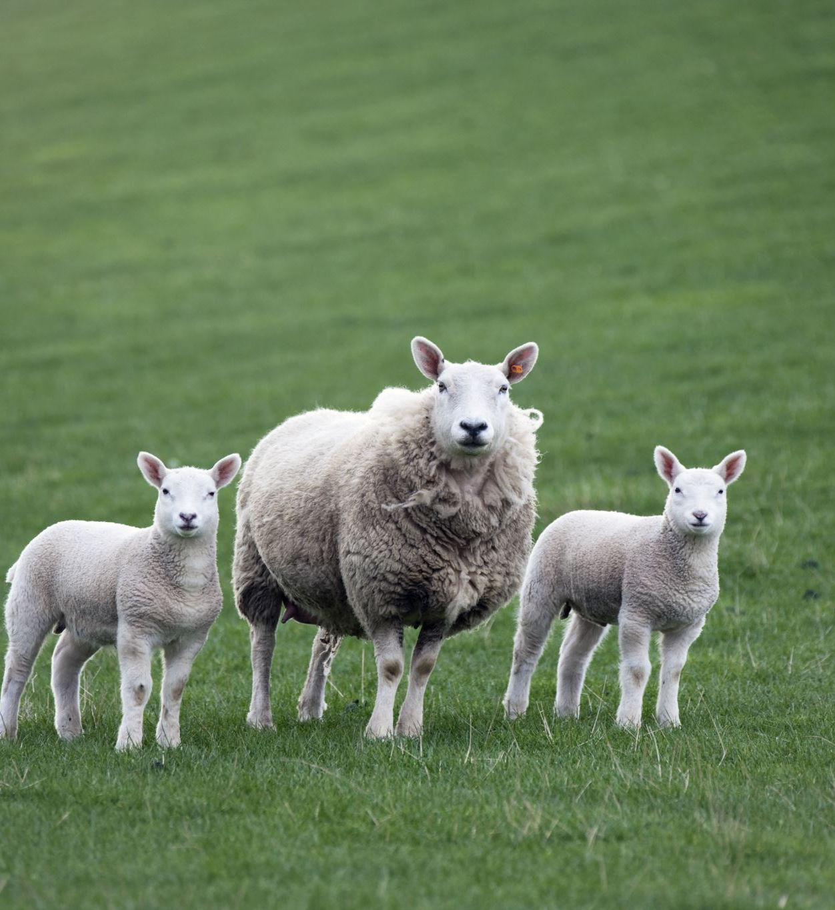
Delinquent Loan Servicing
Lenders may not initiate foreclosure action on a loan until 60 calendar days after eligibility of the borrower to participate in the Interest Assistance (IA) program has been determined by the lender and FSA.
  Note: Currently FSA IA funds are not available. Therefore, lenders will need to document on form FSA-2248 and in the borrower’s case file that IA was considered, but FSA IA funding is not available at this time.

Slide 23
Delinquent Loan Servicing
Lenders will continue to submit form FSA-2248 “Guaranteed Farm Loan Default Status Report” every 60 calendar days until default is cured or until the payment of a final loss claim.
Lenders must decide whether to restructure or liquidate an account within 90 days of default, 120 days after payment due date.
  Note: Prompt follow-up on delinquent payments, early recognition of loan problems and prudent use of restructuring tools are keys to resolving many delinquent loans.

Slide 24
General Reporting Requirements
Form FSA-2241 “Guaranteed Farm Loan Status Report” will be submitted by all lenders as of March 31 and September 30 of each year.
Form FSA-2248 “Guaranteed Loan Borrower Default Status Report “ will be submitted by all lenders when a guaranteed loan becomes 30 days past due and resubmitted every 60 days until default is cured or until the payment of a final loss claim.
Form FSA-2261 “Report on Collection Activities on Liquidated Accounts” will be submitted by the lender annually for 3 years following the payment of a final loss claim on any collection activities.

Slide 25
Debt Servicing Options
FSA Handbook 2-FLP Paragraphs 312, 326 - 328

Slide 26
Debt Servicing Options
Rescheduling of Debt
  Involves changing the payment terms of a loan, such as a change in the term in years of a note or LOC agreement.
Deferrals
  Postpones the payment of principal and interest to accommodate a temporary inability of the borrower to make scheduled payments.
Debt Write-down
  Involves writing off a portion of the outstanding balance of a loan. All lenders much seek FSA concurrence before they execute a debt write-down.

Slide 27
Rescheduling of Debt
Payments will be rescheduled with the following terms:
  FO loans may be amortized over the remaining term of the note or rescheduled with an uneven payment schedule over a period not to exceed 40 years from the date of the original note.
  OL notes may be rescheduled over a period not to exceed 15 years from the date of the rescheduling.
  Line of credit loans may be rescheduled over a period not to exceed 7 years from the date of the rescheduling or 10 years from the date of the original note, whichever is less. Advances cannot be made against a line of credit loan that has had any portion of the loan rescheduled.

Slide 28
Rescheduling of Debt
A new note is not necessary when rescheduling occurs. However, if a new note is not taken, the existing note or line of credit agreement must be modified by attaching an “allonge” or other legally effective amendment, evidencing the revised repayment schedule and any interest rate change.
Interest rate for rescheduled loan is the negotiated rate agreed upon by the lender and the borrower. (Must meet maximum interest rate requirements.)
Lenders may capitalize the outstanding accrued interest when restructuring.
  As a result of capitalizing interest, rescheduled promissory note may increase the amount of principal the borrower is required to pay. However, in no case will such principal amount exceed the statutory loan limits.
  When accrued interest causes the loan amount to exceed the statutory loan limits, rescheduling may be approved without capitalization of the amount that exceeds the limit.
  Late payment fees and default interest penalties may not be capitalized and are not covered under the guarantee.

Slide 29
Rescheduling of Debt
For any restructuring action, the following conditions apply:
Borrower meets the FSA eligibility criteria except the provisions regarding prior debt forgiveness and delinquent on a Federal debt do not apply.
Borrower’s ability to make the amended payment is documented by the following: (SEL and CLP lender only; PLP lender shall see their CMS)
  A feasible plan
  Current financial statements from all liable parties
  Verification of non-farm income
  Verification of all debts (if over $5000)
  Applicable credit reports
  Financial history (and production history for SEL) for the past 3 years to support the cash flow projections

Slide 30
Rescheduling of Debt
For any restructuring action, the following conditions apply (cont’d):
  Loans secured by real estate, equipment and/or breeding livestock can be restructured using a balloon installment.
  The lender may capitalize the outstanding interest.
  If a borrower is current, but unable to make the scheduled payment, a restructure proposal may be submitted prior to the payment coming due.
  The lender’s security position will not be adversely affected because of the restructuring.
  Any holder agrees to any changes in the original loan terms.

Slide 31
Deferrals
Payments may be deferred up to 5 years, but the loan may not be extended beyond the final due date of the note.
  Note: If a LOC deferral exceeds 1 year, then LOC must be restructured, and no new advances can be made.
The principal portion of the payment may be deferred either in whole or in part.
Interest may be deferred only in part.
There must be a reasonable prospect that the borrower will be able to resume full payments at the end of the deferral period.

Slide 32

Deferrals
The amount of principal and interest deferred must be based on the borrower’s current ability to pay, and projections about ability to pay in the future. If the deferral period is to extend beyond 1 year, only a portion of the interest can be deferred.
The loan may be rescheduled after the deferral if payments as scheduled cannot be made.

Slide 33

Deferrals
To request a deferral, SEL lenders must submit documentation like a rescheduling.
CLP lenders will provide FSA with a certification that each requirement has been met, a narrative outlining the circumstances surrounding the need for deferral, copies of any applicable calculations, and copies of any restructured notes, line of credit agreements, or allonges.
PLP lenders will see their CMS and provide documentation upon completion.

Slide 34
Debt Write-down
A lender may only write-down a delinquent guaranteed loan or line of credit in an amount sufficient to permit the borrower to develop a feasible plan of operation.
The lender will request other creditors to negotiate their debts before a write-down is considered.
The borrower cannot develop a feasible plan after consideration is given to rescheduling and deferral.
The present value of the loan to be written down, based on the interest rate of the reschedule loan, will be equal to or exceed the net recovery value of the loan collateral.

Slide 35
Debt Write-down
The loan will be restructured with regular payments at terms no shorter than 5 years for a line of credit and OL term note; and no shorter than 20 years for FO, unless required to be shorter per 2-FLP subparagraph 326 B.
No further advances may be made on a line of credit that is written down.
Loans may not be written down with interest assistance.
The write-down is based on writing down the shorter-term loans first.

Slide 36


Debt Write-down
When a lender requests approval of a write-down for a borrower with multiple loans, the security for all of the loans will be cross-collateralized and continue to serve as security for the loan that is written down.
The write-down will be evidenced by an allonge or amendment to the existing note or line of credit reflecting the write-down.

Slide 37
Emergency Advance vs. Protective Advances
FSA Handbook 2-FLP Paragraphs 283 and 360

Slide 38
Issuing an Emergency Advance Under LOC
In cases of a guaranteed LOC, lenders may make an emergency advance when a LOC has reached its ceiling.
The emergency advance will be made as an advance under the LOC and not as a separate note.
An emergency advance in excess of the original loan amount is made when some deviation causes expenses to exceed the original budgeted amount and is necessary to avoid significant damage to or loss of the security.
An emergency advance shall not be used if its use will cause the total amount of the borrower’s debt to exceed the statutory limit.

Slide 39


Emergency Advance
The lender’s loan documents must contain sufficient language to provide that any emergency advance will constitute a debt of the borrower to the lender and be secured by the security instrument. The following conditions apply:
  The loan funds to be advanced are for authorized operating loan purposes
  The financial benefit to the lender and the Government from the advance will exceed the amount of the advance
  The loss of crops or livestock is imminent unless the advance is made.

Slide 40
Emergency Advance
SEL and CLP lenders must obtain written permission from the Agency before an emergency advance on a guaranteed LOC can be made.
PLP lender may make emergency advances according to their Lender’s Agreement and CMS.

Slide 41
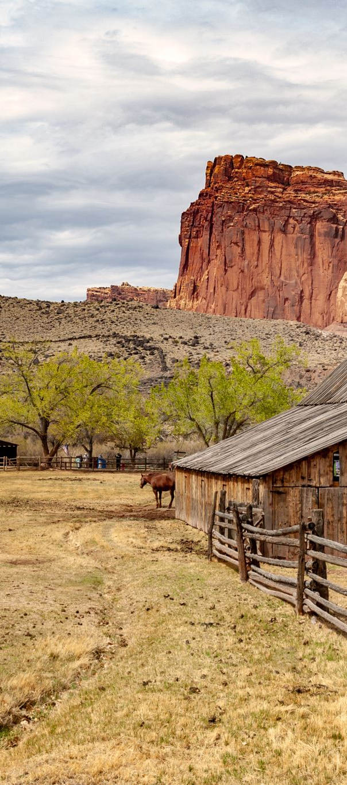
Protective Advances
Protective advances are expenses incurred by a lender to protect or preserve the collateral from loss or deterioration.
Protective advances for guaranteed loans are used ONLY when the borrower is in liquidation, liquidation is imminent, or when the lender has taken title to real property in a liquidation action.
Protective advances may only be made when the lender can demonstrate the advance is in the best interest of the lender and the Government.

Slide 42
Protective Advances
Prior written authorization from the Agency is required for all protective advances in excess of $5,000 for CLP lenders and $3,000 for SEL.
The dollar amount of protective advances for PLP lenders is specified in their Lender’s Agreement and CMS. PLP lenders, for which their CMS does not contain the dollar amount of protective advances allowed, are required to obtain FSA’s written authorization for advances in excess of $5,000.

Slide 43
Questions?

Slide 44
Thank you!
USDA is an equal opportunity provider, employer, and lender.

